Slide 1
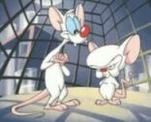
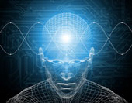
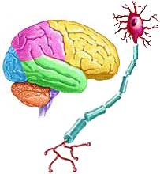
Chapter #3: Brain, Body, and Behavior

Slide 2
Chapter Objectives:
Name and explain the parts of the cerebral cortex.
Describe how the hemispheres of the brain function.
Name and describe the purpose of each of the parts of the lower brain.
Describe how neurons communicate.
Describe the central and peripheral nervous systems and their parts.
Name and explain the purpose of each of the endocrine glands.

Slide 3
Facts about the Brain…
The adult human brain weighs 3lbs.
C
D
E
F
G
H
I
J
K
L

Slide 4
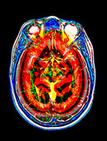
Examining the Brain
Psychologists study the brain
in detail because it is the part
of us that controls every
thought, action, and feeling.
The brain is the most demanding
organ of the body:
uses 20% of the oxygen we breathe in,
eats up most of the sugar we take in,
operates on 20 watts of electrical power.
The brain is also made up of about 100 billion nerve cells!

Slide 5
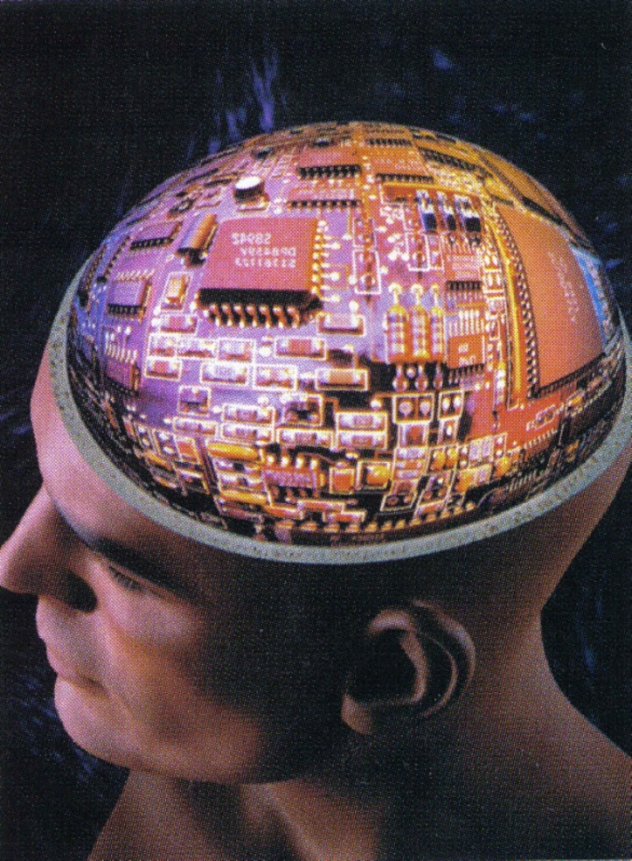
The Cerebral Cortex
The cerebral cortex is the outermost layer of the brain that controls very high-level mental processes, such as thought.
(cerebral means “relating to thought or intelligence.”)
There is no computer on the planet, nor is there anything in this known universe, that can equal the processing capabilities of the brain.

Slide 6
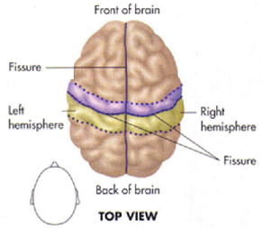
The Hemispheres
The brain is divided into halves by a depression running from the front to the back called a fissure. This fissure marks the division of one half of the brain from the other, with each half called a hemisphere.
Hemi means half, so we
have two halves of a
sphere.
The two sides of the brain
are referred to as the left
and right hemispheres.

Slide 7
Each hemisphere controls the opposite side of the body, or in other words -
the left hemisphere controls movements and sensations on the right side of the body, while the right hemisphere controls movements and sensations on the left side of the body.
If you were to pull the right and left hemispheres apart, about midway down, you will find a bundle of fibers called the corpus callosum.
this unit contains several million nerve fibers that help each half of the brain communicate and transmit information with the other.

Slide 8
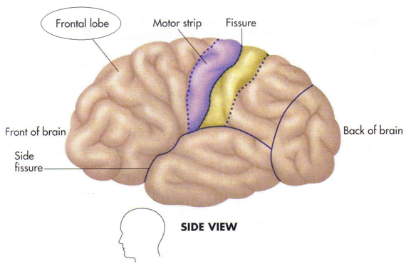
The Lobes
The cerebral cortex is divided into four major sections called lobes.
The frontmost area of the brain is
conveniently called
the frontal lobe.
This division of the cerebral cortex contains the motor strip, or a band running down the side of the frontal lobe that controls every part of the body that moves; hence the name “motor” strip.

Slide 9
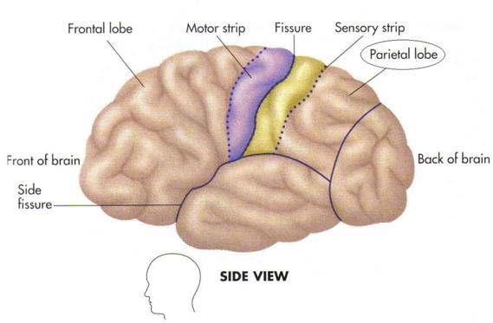
The area directly behind the frontal lobe is called the Parietal lobe.
The parietal lobe contains the sensory strip, or a band running down the side of the parietal lobe that registers and provides all forms of sensation; hence the name “sensory” strip.

Slide 10
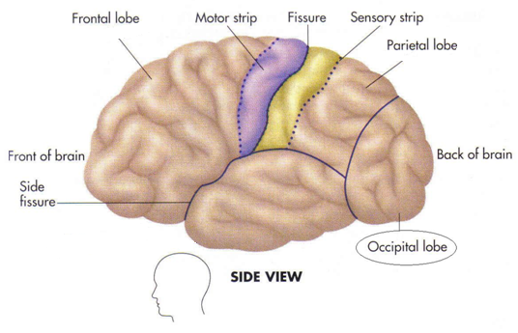
The area in the very back of the brain is called the Occipital lobe.
The occipital lobe is devoted to making sense out of what we see. Everything that you see through your eyes is coded and sent through nerves to the occipital lobe.
“Seeing stars” occurs when you suffer a blow to the front of the head, sending the brain backwards and crashing the occipital lobe into the skull. The electrical system that powers this part of the brain is stirred up by the impact of the blow and ends up creating these strange images.

Slide 11
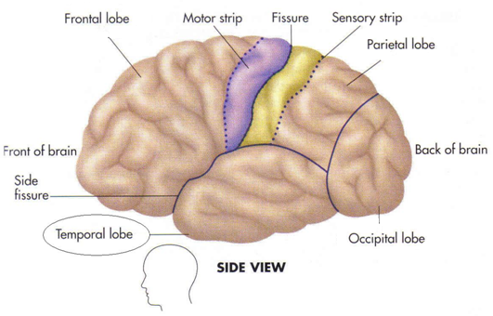
The bottom area of the cerebral cortex is called the temporal lobe.
The temporal lobe contains the major centers for hearing. There is also some speech functions that the Temporal lobe is responsible for, but there is an overlap with other lobes to handle all aspects of hearing and language.

Slide 12
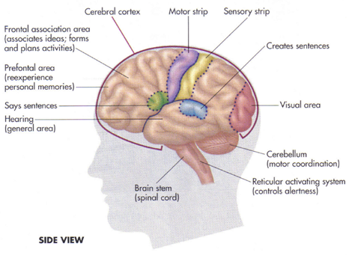
The Frontal Lobe – a detailed examination
The frontal lobe of the cerebral cortex has a number of complex and fascinating functions, one of which is the ability to “see” or re-experience past events from our
personal lives. The
part of the frontal
lobe that enables us
to do this is called
the prefrontal area.
Whenever you
“mentally travel
in time,” you are
using the
prefrontal area.

Slide 13
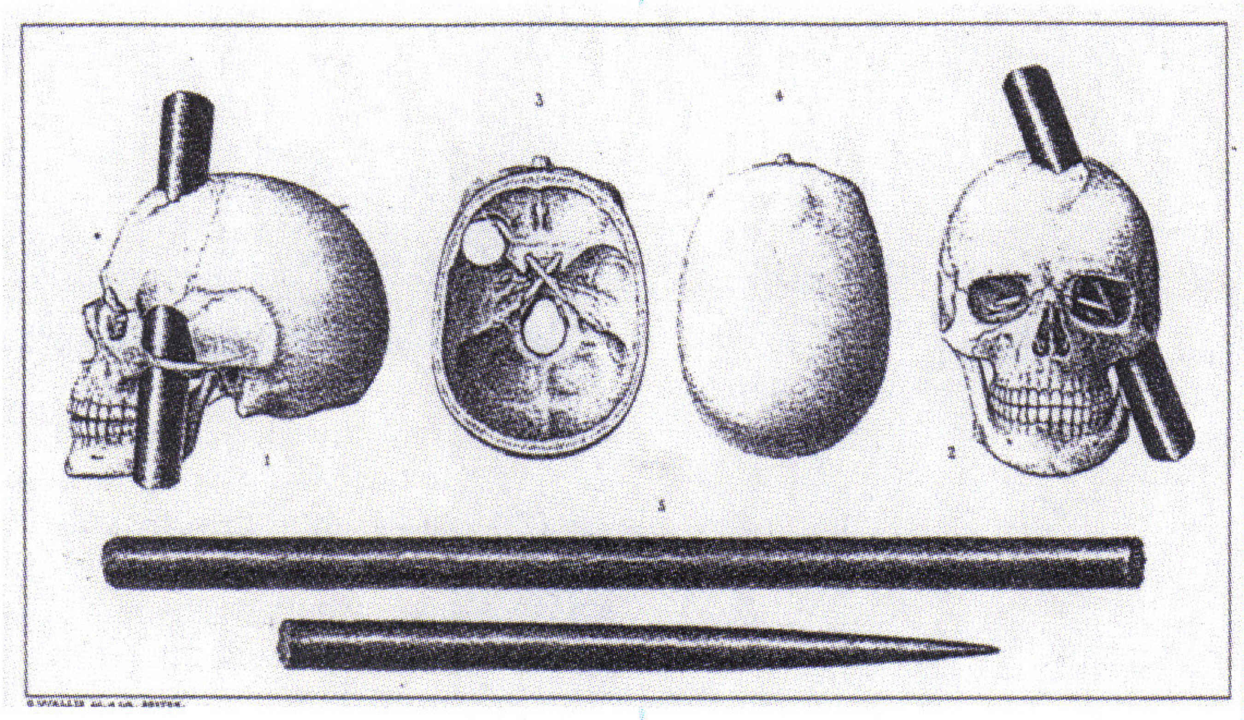
The story of Phineas Gage
Coming up with strategies or plans of action is another function of the frontal lobe. The frontal association area is the part of the frontal lobe that engages in elaborate associations or mental connections.
The frontal association area forms the core of the personality, since it is the primary decision-making area of the brain. This area interprets what is going on and then tells us what to do and what to feel. It also tries to make sense of the environment.
Someone with damage to this part of the brain may know what is happening but may not be able to bring together all the aspects of the situation.
For example…
A man with damage to this area can watch someone: (1) take a bullet, (2) put it in a gun, (3) cock the gun, and (4) aim it directly at him, but will not show any concern. He understands each act by itself, but can’t link them all together.

Slide 14
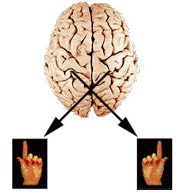
Hemispheres and Dominance
One hemisphere of your brain has dominance over the other, or in other words, one hemisphere is always the preferred one to use.
Most people are left-hemisphere
dominant and right-handed. But
if the person is right-hemisphere
dominant, then the person will be
left-handed for all fine movements
(i.e. writing or putting your finger
in your ear.) You are considered “ambidextrous” if you are both right and left handed.

Slide 15
Are intelligence levels higher in left-handed people over right-handed people?
Studies show intelligence is about the same between the two groups, but statistically, left-handed people tend to do better in art, music, and mathematics, while also being better actors.
Fact or Fiction???
If a left-hander is forced to use the right-hand in childhood, will this lead to insanity?
People used to think that something was wrong with
left-handers, so parents sometimes tried to change their left-handed children.

Slide 16
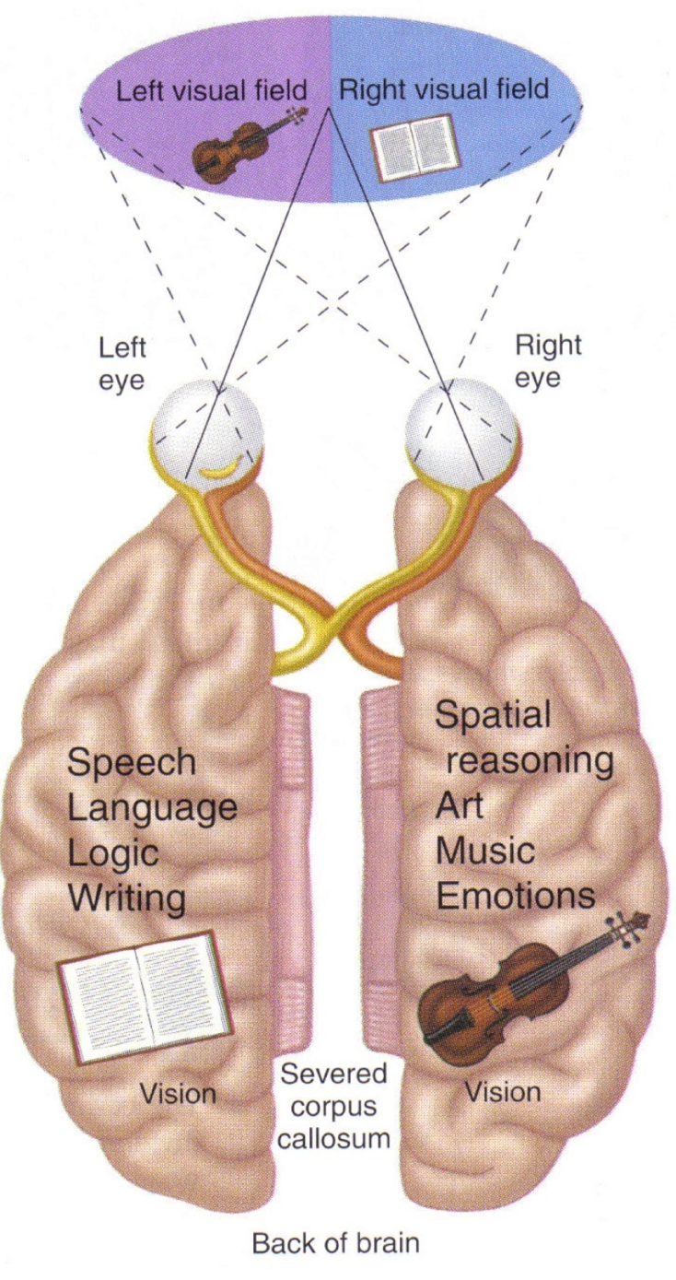
“Assumed” Areas of Specialization in the Cerebral Cortex
Left Hemisphere
handles verbal or speech
material. People who are “left-
brained” typically excel in writing and math, as well as logic and reasoning skills.
Right Hemisphere
deals with objects in space
(i.e. spatial reasoning), art,
music, and some mathematical
reasoning, as well as emotional
material, such as acting.
Essentially – all nonverbal activities.

Slide 17
Some say there is significant differences between the two hemispheres and that each operates in a very specialized way.
NOT TRUE!!!
The hemispheric functions already
discussed are quite real and easy to
demonstrate. However, it is
important to keep in mind that the
hemispheres work together in virtually
everything we do.

Slide 18
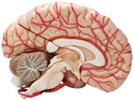
The Lower Brain
Deep inside the skull lies the lower brain, with the cerebral cortex fitting over and around it.
The word “cortex” means “bark,” as on a tree.
For most human responses (with the exception of automatic responses), the cortex influences the lower units; they, in turn, influence the cortex.
The Thalamus
An oval mass of nerve cells
that acts as a relay station
to send incoming and outgoing
messages to and from various
parts of the brain.

Slide 19
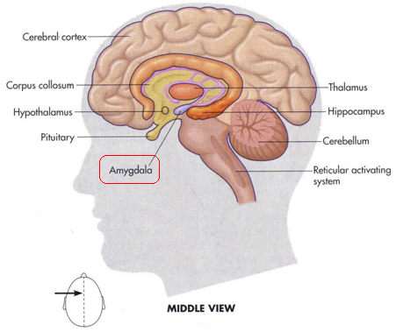
for example: If you want to move your big toe, the brain sends a message to the thalamus, which then sends the message to the correct place on the motor strip.
The Limbic System
The limbic system contains the structures involved in basic emotions and, to some extent, memory.
The amygdala is primarily responsible for emotional responses – especially anger and aggression.
Damage to the amygdala would inhibit aggression.

Slide 20
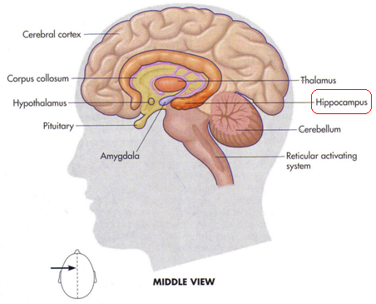
The hippocampus enables us to form memories. While memories are not stored in the hippocampus itself, it is a crucial structure in assembling information from elsewhere in the brain.
Damage to the hippocampus would makes forming new memories impossible. Memories already stored are not
forgotten, but new ones cannot be made.
It is important to note that the prefrontal area (cortex) and the
hippocampus are two separate entities within the brain. The
prefrontal area (cortex) enables us to re-experience personal
events/memories from the past, while the role of the hippocampus
is involved in the formation of memories.

Slide 21
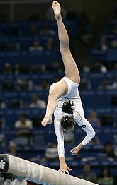
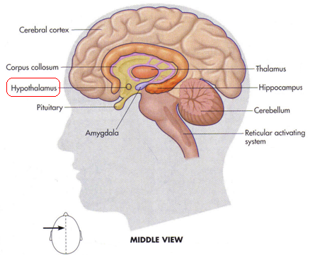
The Hypothalamus (“hypo” means “below”) is the size of a pea and sits below the thalamus. Its primary function is to help control pleasure, hunger, thirst, and sexual desire.
Motivation and emotion are directly linked to the hypothalamus.
The Cerebellum
The cerebellum is part of the lower brain that
coordinates and organizes
bodily movements for
balance and accuracy. It is
hooked to the base of the brain below the occipital lobe and
works in accordance with the motor strip to keep proper balance, coordination, and direction.

Slide 22
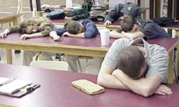
The Reticular Activating System (RAS)
The reticular activating system (RAS) is the alertness control center of the brain and serves to regulate activity levels within the body; it is also called the reticular formation.
This area sits at the base of the brain inside the spinal cord and acts like a net to catch nerve impulses passing from the body to the brain and the brain to the body. The RAS monitors this impulses and regulates activity levels within the body. It also regulates how alert or how sleepy we are.
example: If there are a number of things going on around you, multiple impulses arrive from the body and brain and alertness increases. If everything is quiet around you, impulses decrease and you’ll likely feel inclined to fall asleep. The RAS is quite sensitive to sounds, therefore the body will desire to fall asleep when exposed to steady sounds for a period of time.

Slide 23
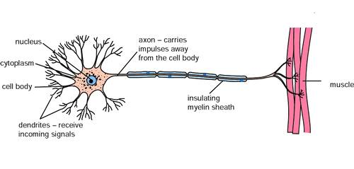
Brain Communication
How do all the parts of the brain communicate with each other and with other parts of the body?
The Neuron
A nerve cell is called a neuron. This cell transmits electrical and chemical information (via neurotransmitters) throughout the body.
The body of the neuron has a number of fibers sticking out from it. Dendrites are the shorter fibers containing receptors (receivers) for neuronal messages.
“Dendrites” is a word meaning “tree.” They are called this because they look like the branches on a tree.

Slide 24
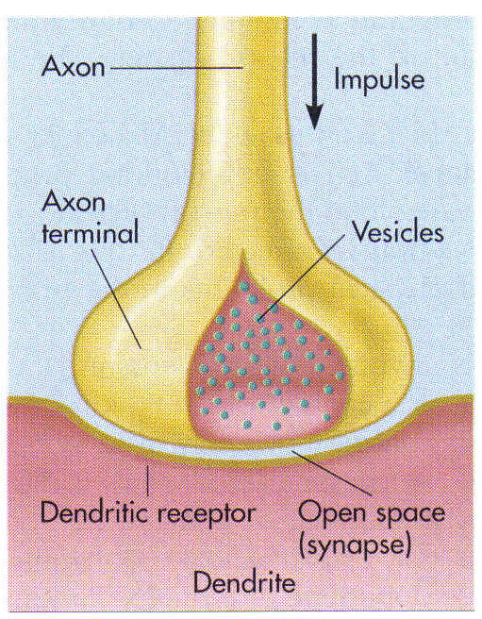
Dendrites receive information from other nerve cells and send it through the cell body to the axon. The axon is part of the neuron that carries messages away from the cell to the dendrites of another neuron.
At the end of the axon are thousands of terminals, each sitting opposite a receptor for another neuron. Therefore, the messages comes to a receptor on a dendrite, goes through the cell, travels along the axon, then out through the axon terminal to the dendrites of another neuron.

Slide 25
The Synapse
The space between the endings of the axon and the waiting dendrites of another neuron is called the synapse (or synaptic gap.)
the word “synapse” means “junction point.”
Neurons work by electricity, and since neurons are not directly connected due to the synapse, these electric messages would stop at each neuron with the help of…
NEUROTRANSMITTERS!

Slide 26
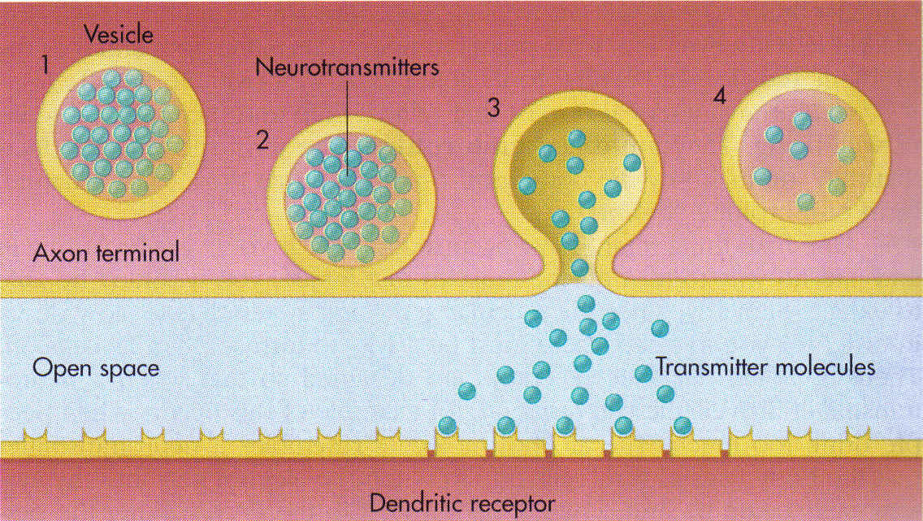
Neurotransmitters
The area where the axon ends, just before the synapse, is filled with small containers that look like bubbles. These containers are called vesicles.
Inside each vesicle sits thousands of molecules called neurotransmitters. Neurotransmitters are chemical “messengers” that “transmit” nerve information from the axon terminal, through the synaptic gap, to the dendritic receptor of the next neuron.

Slide 27
The most common and well-studied neurotransmitter is called acetylcholine, or Ach for short. This neurotransmitter regulates basic bodily processes, such as movement.
When you go to move your arm, the acetylcholine will very rapidly fire every nerve cell in sequence as your arm moves toward something.
Ach is also involved in memory. In many cases of Alzheimer’s disease, an area of the brain that produces acetylcholine is not working properly. Thus, less of this neurotransmitter is available to the person.
Dopamine is another neurotransmitter required for everyday movements. People with a shortage of dopamine would have a difficult time controlling their everyday movements. A shortage of dopamine plays a central role in Parkinson’s disease.

Slide 28
Parkinson’s disease is the only disease we know of that is caused by the shortage of a single neurotransmitter. The cells that make dopamine die off, resulting in less of the needed neurotransmitter being produced.
Endorphins are neurotransmitters that exist to relieve pain and increase our sense of well-being.
(Muhammad Ali suffers from Parkinson’s disease.)
Endorphins are made by the body itself and act as a natural form of morphine.

Slide 29
Turning “off” neurotransmitters…
Since neurotransmitters fire in rapid sequence in order to cause movement, there are some dendritic receptors that are designed to turn the cell off when the neurotransmitter arrives, thus inhibiting certain movements and actions. For example…
When people drink too much alcohol, the alcohol molecule closely resembles a neurotransmitter that the body uses to turn cells off. When cells are turned off in the RAS, this makes the person sleepy; in the speech area it makes the person slur; in the cerebellum it would cause the person to lose their balance and fall over; and so on.
Breathing is another example… without these special receptors, our bodies wouldn’t know to exhale once our lungs are full from inhaling.

Slide 30
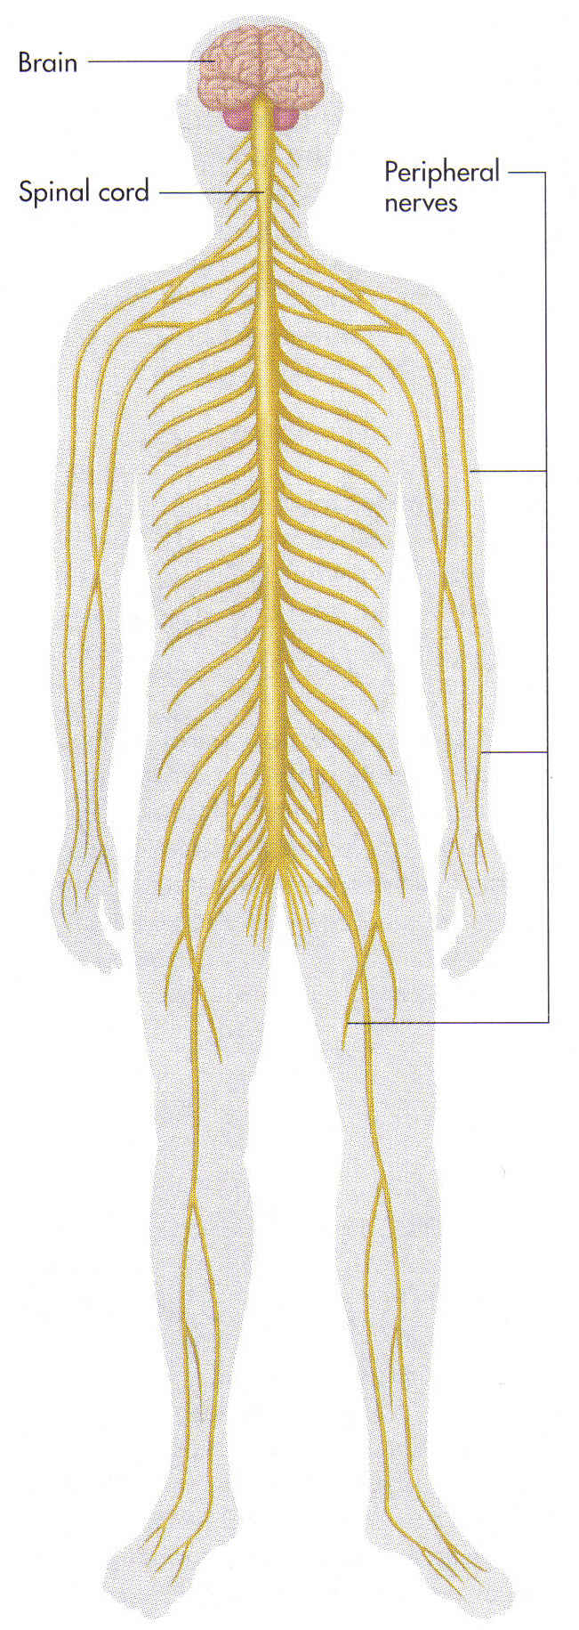
The
Central and Peripheral Nervous Systems The overall structure of the body’s system of nerves is divided into parts and is based largely on where the nerves are located and what areas of the body are involved. The two major divisions are the central and peripheral nervous systems.
The Central Nervous System The brain and spinal cord together make up the central nervous system.
The spinal cord is part of the body that functions as an automatic “brain” in its own right. It serves to relay nerve impulses from the brain to the body, as well as from the body to the brain. All of these impulses must enter and leave through the spinal cord.

Slide 31
Reflexes are automatic behaviors involving body movement that are activated in the spinal cord without use of the brain.
example: You are about to hit another car, but before you know it, you have swerved and missed it. In situations such as this, the brain does not act, but the spinal cord does. The spinal neurons in the spinal cord are short, direct, and very powerful, thus allowing for quicker reaction time in emergency situations. Spinal neurons have very few synapses to slow them down, but have just enough to send a quick message to the brain about what happened.
In theory…
The spinal cord could operate by itself. Experiments have been performed on frogs whose heads had been severed and its lower extremities still functioned for a short time afterward.
However, in a truly gory experiment taking place in France many years ago, scientists tried talking to the heads of men who had just had them cut off in an execution. The heads did not answer. ☺

Slide 32
The Peripheral Nervous System
Take away the brain and spinal cord, and all remaining nerves in the body make up the Peripheral Nervous System. The peripheral nervous system is further broken down into two parts: the Somatic Nervous System and Autonomic Nervous System.
The Somatic Nervous System
Sensory and motor nerves comprise the somatic nervous system. These nerves pick up information and relay it to the brain and spinal cord.
example: your finger touches something that has a rough texture. Sensory nerves in your finger send that information to the brain via the spinal cord. The movement you made to touch the object was controlled by motor nerves receiving instructions from the brain and spinal cord. Whenever we voluntarily move in some way, the somatic nervous system is involved.

Slide 33
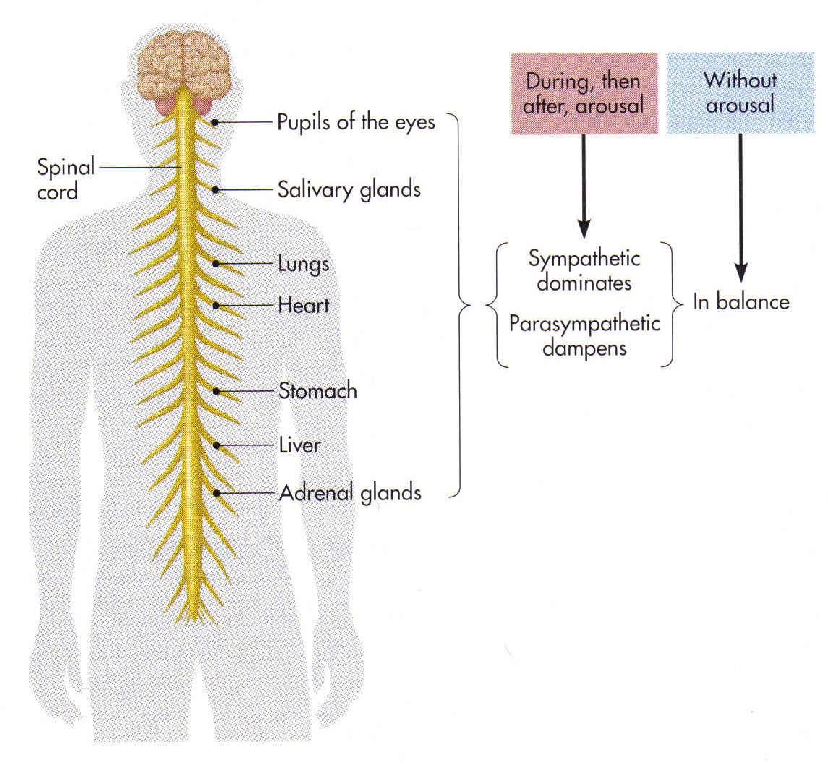
The Autonomic Nervous System
Most bodily activities you perform in a given day are not under your voluntary control. You don’t make yourself breathe in and out, you don’t force your heart to beat, nor do you make your stomach digest food. Therefore, the system that controls all of the body’s “automatic” functions is called the Autonomic Nervous System.
The word “autonomic” means independent or functioning on its own, without conscious control.
This portion of the peripheral nervous system regulates our vital organs and glands, thus controlling our breathing, heart rate, digestion, etc. as well as the neurons connecting these functions/organs to the spinal cord.
NOTE: A number of these automatic functions can be overridden by the higher brain.

Slide 34
For example…
When facing an emergency situation, your brain can trigger an internal emotional response (i.e. fear, panic), which may lead to: an increase in heart rate and blood pressure; an increase in respiration; the liver becoming highly active by producing sugar in response to this “emergency;” the stomach slowing digestion due to increased blood flow to other areas of the body for the emergency; and your pupils to dilate (open up) to better take in the details of the scene. Reactions to emergency situations, such as the one outlined above, are regulated by the first of two divisions of the autonomic nervous system called the Sympathetic Nervous System.

Slide 35
The Sympathetic Nervous System is a division of the Autonomic Nervous System that engages the “fight or flight” response to an emergency situation – to either stay and handle the situation or to run from it.
This system energizes and prepares us for emergencies.
While the sympathetic nervous system shoots up our energy levels to prepare us for emergencies, the second division of the autonomic nervous system, known as the Parasympathetic Nervous System, works against the sympathetic nervous system to lower and conserve our energies, thus bringing our autonomic nervous system back into balance.
When there is no emergency (without arousal), the two divisions of the autonomic nervous system are more or less in balance throughout the day. Try to think of the two divisions of the autonomic nervous system in the following way… the sympathetic nervous system shoots our energy levels up in response to an emergency, while the parasympathetic nervous system serves as a “parachute” to bring us back down to the ground (or back to normal).

Slide 36
The Endocrine System
Communication by neurons is speedy and efficient, but it doesn’t last long – some messages need to stay in the system longer. These messages come in the form of hormones, which are passed through the body in the bloodstream. Hormones are chemical regulators that control bodily processes such as emotional responses, growth, and sexuality.
Hormone comes from a word meaning ‘to activate.”
These chemicals are held inside glands, and can turn on other parts of the body. Glands that release hormones and the hormones themselves make up the endocrine system.
Hormones work like neurotransmitters in that they have a special molecular structure that must match the structure of the receptor.
example: there is a hormone-receptor pair designed only for a woman about to give birth. When the time comes, the hormone is sent through the bloodstream to the proper area, where it locks onto its receptor and starts muscular contractions. If a woman never has a baby, this hormone is never used.

Slide 37
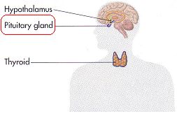
The Pituitary Gland
The pituitary gland is called the master gland of the body. This gland is a small, bean-shaped unit that is attached to and controlled by the hypothalamus.
The pituitary has two jobs:
1) to send messages that will start other glands going, and
2) to determine how tall or short we will be.
The pituitary gland also makes a growth hormone, but does it in fits and starts – meaning its action is delayed, causing people to either be delayed in their growth or achieve growth faster than others.
When the pituitary gland isn’t working properly, this can lead to irregularities in growth.

Slide 38
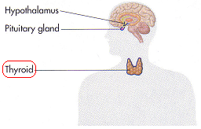
The tallest known person in the world measured in at 8 feet 11.1 inches tall, while the shortest known person measured in at 23.2 inches tall.
The pituitary requires a normal environment and proper nutrition in which to function properly. When these factors are denied, it can lead to stunted growth due to a reduced amount of growth hormone being secreted.
The Thyroid Gland The thyroid gland looks like a bow tie and is located inside the neck.
The thyroid gland controls and regulates the speed of bodily processes, otherwise known as metabolism. It can also play a part in emotional state as well. Overactive thyroid = jumpy; highly energetic; unable to sit still; restlessness; anxiousness; and anxiety. Underactive/slow thyroid = sluggish; sad mood; even depression in some cases. Very slow thyroid from birth = can lead to mental retardation

Slide 39
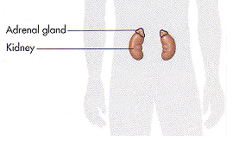
The Adrenal Glands The adrenal glands cause excitement by releasing a chemical called adrenaline into the bloodstream, which in turn, prepares the body for an emergency or for an important activity. Adrenaline increases blood pressure, respiratory rate, and energy level. The adrenal glands are located on both the right and left sides of the body, slightly above the navel and to the back.
In the event of heightened excitement or an accident, the following course of action usually occurs… 1) fast-acting spinal nerves cause us to physically react to the situation, 2) the cerebral cortex sends an emergency message to the hypothalamus, 3) the hypothalamus sends a message to the pituitary gland,

Slide 40
4) the pituitary gland sends hormones to the adrenal gland, 5) the adrenal glands release adrenaline into the blood stream, which: a) increases respiratory rate and elevates blood pressure, b) muscles tense, c) sugar is dumped into the body for energy, and d) makes us sweat.
The Gonads
The gonads are the sex glands that produce sperm or eggs for reproduction.
The male sex hormone is called androgen The female sex hormone is called estrogen
BOTH males and females have both hormones in their bodies; however, males will have more androgen, while females will have more estrogen. These hormones make us look either male or female.
For instance…
If a female is injected with additional androgen, she will grow body hair and a beard. Androgen also starts the sex drive for both males and females.

