Slide 1
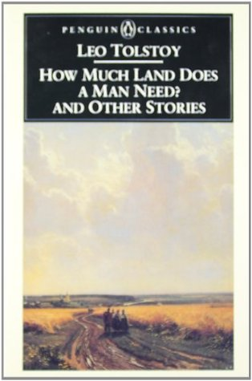
Leo Tolstoy’s How Much Land Does a Man Need?
IN THIS SHORT STORY WE ARE PRESENTED WITH A CHARACTER, PUHOM, WHO IS DRIVEN BY GREED. HE DOES NOT SIMPLY WANT MORE “THINGS”, HE IS OBSSESSED WITH IT. THIS OBSSESSION ULTIMATELY LED TO HIS DEMISE.

Slide 2
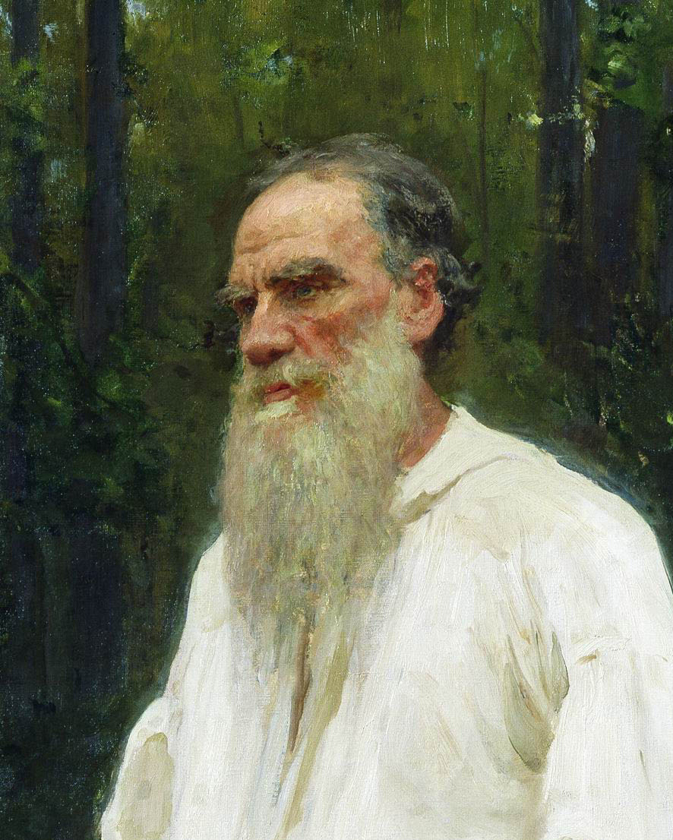
LEO TOLSTOY
1828-1910
Russian author who primarily wrote works of fiction
Was homeschooled by German and French tutors
Only 10 of his 13 children lived past infancy
Most known for War and Peace
Died during a pilgrimage to escape marriage issues

Slide 3
A MARXIST INTERPRETATION
ALIENATION: PUHOM IS CONSTANTLY BREAKING AWAY FROM THE PACK TO SEEK LIFE BY HISELF. HE EVEN ABANDONS HIS FAMILY WITH NO ONE BUT A SERVANT AND ULTIMATELY, DIES ALONE.
BOURGEOISIE VS PROLETARIAT: THERE IS A CLASS BATTLE GOING ON IN THIS STORY. PAHOM IS TRYING TO BETTER HIS LIFE FROM A LAND WORKER TO A LAND OWNER.

Slide 4
A MARXIST INTERPRETATION
COMMODITY: PAHOM’S LIFE IS DRIVEN BY GOODS, IN THIS CASE, LAND. IT IS HIS UNDERSTANDING THAT BY HAVING MORE LAND, HE WILL BE A BETTER AND HAPPIER MAN.
VALUE: FURTHERMORE, PAHOM BELIEVES LIFE IS ONLY AS WORTH THE AMOUNT YOU HAVE. THEREFORE, HIS LIFE’S VALUE IS THE OVERALL VALSUE OF THE THINGS HE HAS.

Slide 5
SO WHAT?

